Slide 1
Cyclistic Presentation
Gabriel Gelbcke

Slide 2
ABOUT THE COMPANY
STORY
VISION
In 2016, Cyclistic launched a successful bike-share offering. Since then, the program has grown to a fleet of 5,824 bicycles that are geo-tracked and locked into a network of 692 stations across Chicago. The bikes can be unlocked from one station and returned to any other station in the system anytime.
Cyclistic’s finance analysts have concluded that annual members are much more profitable than casual riders. Rather than creating a marketing campaign that targets all-new customers, we have a solid opportunity to convert casual riders into members.

Slide 3
OBJECTIVE
Design marketing strategies aimed at converting casual riders into annual members. In order to do that, however, the team needs to better understand how annual members and casual riders differ, why casual riders would buy a membership, and how digital media could affect their marketing tactics.

Slide 4
QUESTIONS
DIFFERENCE
How do annual members and casual riders use Cyclistic bikes differently?
INFLUENCE
How can Cyclistic use digital media to influence casual riders to become members?
WHY ?
Why would casual riders buy Cyclistic annual memberships?
ACT
How should we act on the insight of my analysis?

Slide 5
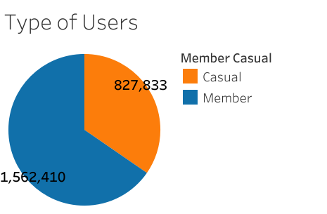
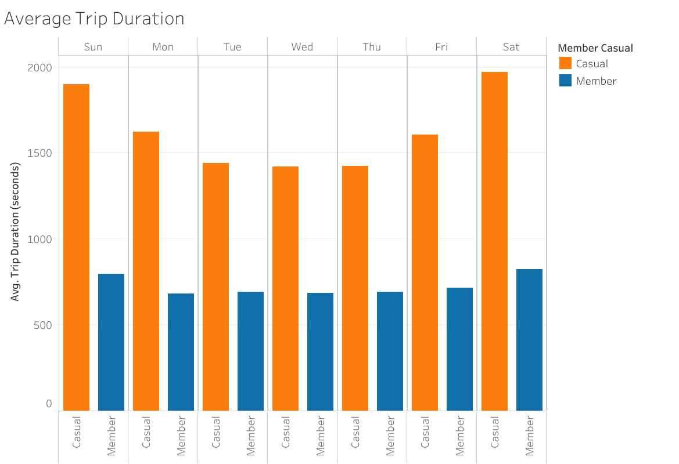
Usage style
Casual / Member
TRIP DURATION
Casual are users that doesn’t have a annual subscription.
Visualization to provide information about how long a trip usually takes.
Notes:
AVERAGE TRIP DURATION IN MINUTES (PUT EMPHASIS ON THIS PART, DUE TO THE STRATEGIES SECTION) -> Members uses our bikes for an average of 13:11 as for casual users that uses for an average of 26:41. As we can analyze, the time that casual users uses our bikes are pretty much the double as of our members.

Slide 6
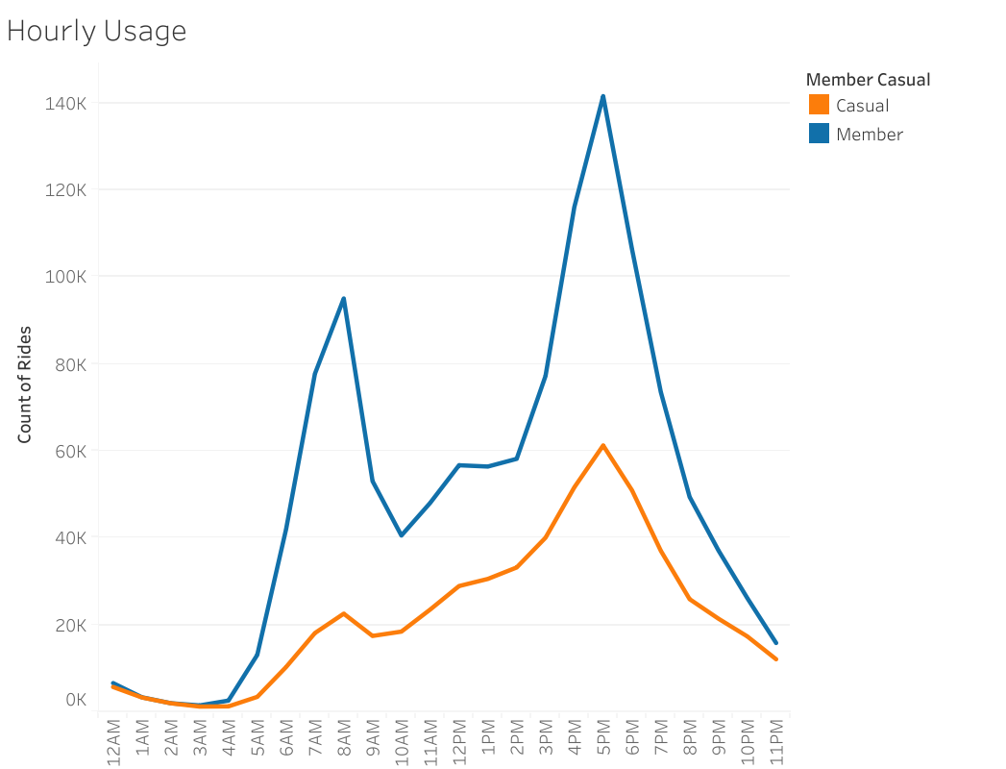
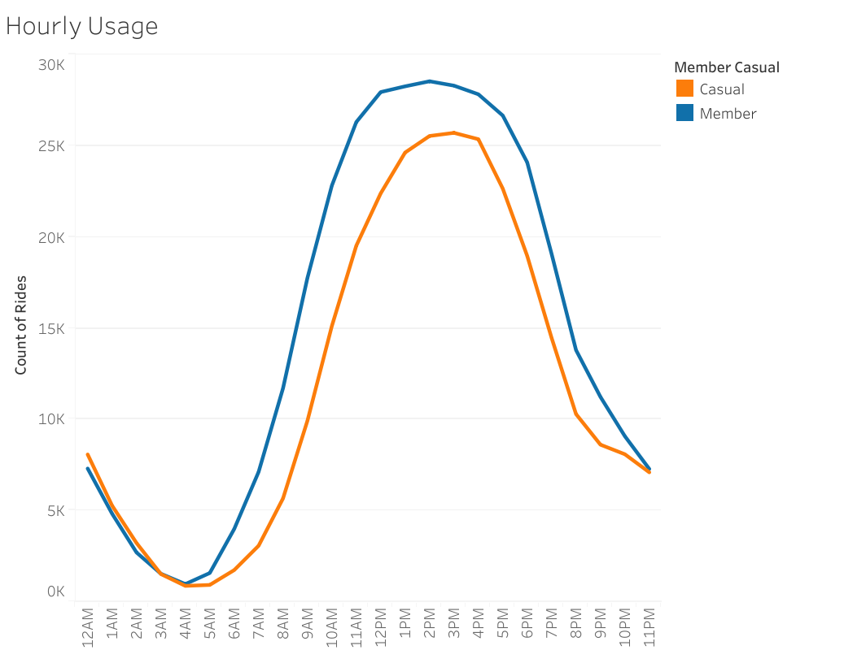
Understand the hourly usage
Weekdays
Weekends

Slide 7
Understand the hourly usage
Weekdays
Weekends
Notes:
WEEKDAYS -> We can see an increase of rides on three moments of the day, 8am, 12pm and around 5pm. Alongside this information, we can interpret that most members uses our bikes for going to work, during lunch break and to return from work to home, the interesting part is that we also have an increase on those same times for casual members, this gives us an opportunity to try to convert casual members to actual members.
WEEKENDS -> On weekends is pretty constant, but with a high peak on the best time of the afternoon.

Slide 8
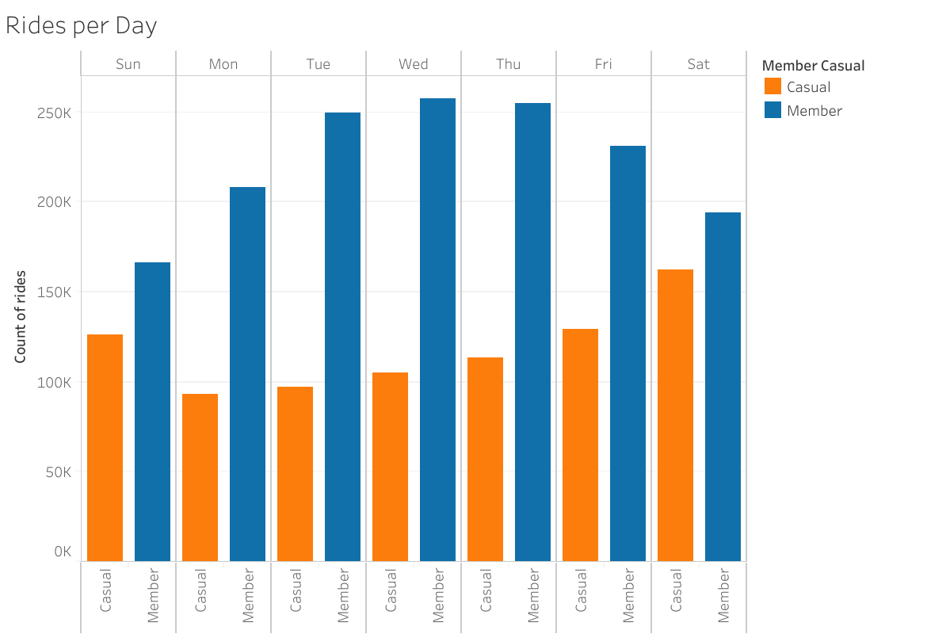
UNDERSTAND THE DAILY USAGE
CASUAL USAGE
Comparing the weekend with weekdays, the usage for casual users gets an increase of around 34.58% on weekends.
Notes:
After understanding the hourly usage, we can check a little bit further with our rides per day. The usage for casual users increases as the week ends, as we understand that a good amount of them uses our bikes on the same time as members, we can have an idea of who our casual users are.

Slide 9
FINDINGS
WHO ARE OUR MEMBERS?
According to the data. It seems like most of our members are working adults that uses our bikes to go to work and return home, as a method of transportation.
WHO ARE OUR CASUAL USERS?
Part of them could be family members that uses our services to enjoy some fun time as the number of casual usage increases on weekends, however, some of them could be working adults, due to the increase of rides on rush hour.

Slide 10
STRATEGIES

Slide 11
STRATEGIES
PEAK USAGE ON WEEKENDS
A considered number of casual rides increases on weekends, there could be new options for subscriptions, like a quarterly subscription which allows you to use the bikes on weekends + Fridays.

Slide 12
STRATEGIES
PEAK USAGE ON WEEKENDS
A considered number of casual rides increases on weekends, there could be new options for subscriptions, like a quarterly subscription which allows you to use the bikes on weekends + Fridays.
RUSH HOUR USAGE
There is a peak usage at rush hours on weekdays, so a marketing campaign could be launched for those people that are probably also workers that uses our services on a less frequent rate.

Slide 13
STRATEGIES
PEAK USAGE ON WEEKENDS
A considered number of casual rides increases on weekends, there could be new options for subscriptions, like a quarterly subscription which allows you to use the bikes on weekends + Fridays.
RUSH HOUR USAGE
There is a peak usage at rush hours on weekdays, so a marketing campaign could be launched for those people that are probably also workers that uses our services on a less frequent rate.
PRICING
It is suggested that an increase on single-day prices happens. With that increase of price, an annual membership would seem more profitable for the normal user.
Notes:
PRICING -> Another good strategy for pricing, would be to insert additional fees based on trip duration, because casual users usually uses our bikes for double the time of members, with that new fee, the subscription would also be more interesting for the casual user.

Slide 14
THANK YOU
Gabriel Gelbcke​
gabrielgelbcke@gmail.com
www.contoso.com

